Slide 1
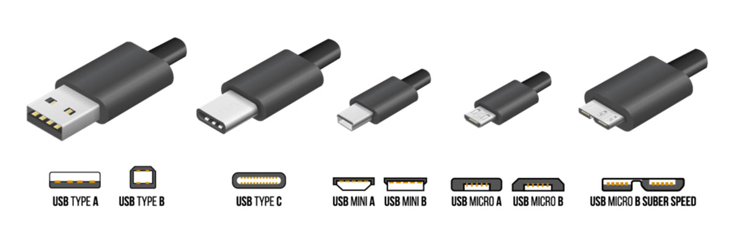
CSE360-Computer Interfacing BRAC University Different Types of USB

Slide 2
USB Standards
Release Name | Release Date | Speed | Power
USB 1.0 | January 1996 | Low speed – 1.5 Mbit/s | 500 mA
USB 1.1 | August 1998 | Full speed – 12 Mbit/s | 500 mA
USB 2.0 | April 2000 | High Speed 480 Mbit/s | 500 mA and 5 V
USB 3.0 | November 2008 | Superspeed – 5 Gbit/s | 900 mA and 5 V
USB 3.1 | January 2013 | Superspeed+ – 10 Gbit/s | 3000 mA and 5 V
USB 3.2 | July 2017 | Superspeed+ – 20 Gbit/s | Up to 100 watt
USB 4.0 | August 2019 | 40 Gbit/s | Up to 100 watt
Wireless USB | September 2010 | 53- 480 Mbit/s | 900 mA and 5 V

Slide 3
USB Standards
Previous versions are half duplex that mean data can no be transmitted and received simultaneously.
USB 3.0 is full duplex and allows bi-directional data transfer.
If we connect a USB 3.0 pen drive in USB 3.0 ports in computer, we can send and receive data at the same time.
If we connect a USB 2.0 pen drive in USB 2.0 ports in computer, we can do only one operation at a time.
No need of external power source to supply power USB 3.0 standard devices.

Slide 4
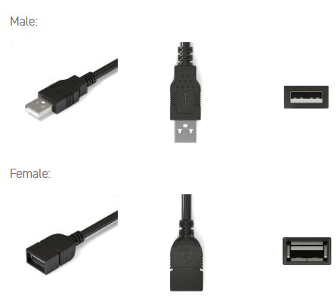
USB Type - A
USB Type-A is the familiar rectangular port
Act as a Host
Provides power to the connected devices.
Example: Gaming PC, Laptop, Television etc.

Slide 5
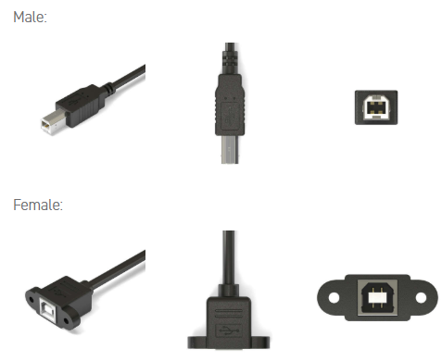
USB Type - B
USB Type-B port is a blocky, square-shaped plug.
While connecting with type – A, act as a receiver.
Example: Hard drives and Printer etc.

Slide 6
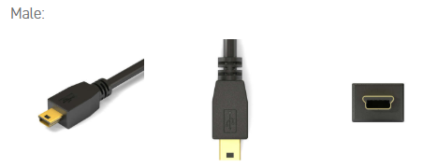
USB Mini - B
Due to unsuitable size of USB Type – B, type Mini – B has been manufactured.
This 5-pin Mini-b is the most popular style of Mini-b connector.
This connector is quite small, about two-thirds the width of an A-style connector.
Example: Cellphones, GPS units, PDAs, digital cameras, specially Sony devices like old Wacom devices, PlayStation 3 Controller, etc.

Slide 7
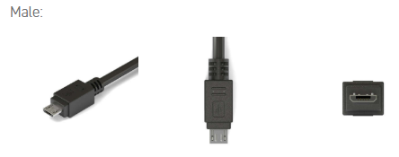
Micro USB - B
Smaller in size and faster in speed to a USB Mini-b
Support the high speed transfer rate of 480 Mbps and On-The-Go features.
Identified by black-colored receptacle and compact 5 pin design.
Example: Cellphones, GPS units, PDAs and digital cameras, Bluetooth headphones, external battery pack, PlayStation 4 controller, Microsoft X box controller for charging external battery pack for it.

Slide 8
USB On-The-Go (OTG)
USB OTG allows those devices to switch back and forth between the roles of host and device.
A mobile phone may read from removable media as the host device, but present itself as a USB Mass Storage Device when connected to a host computer.
USB OTG introduces the concept of a device performing both master and slave roles – whenever two USB devices are connected and one of them is a USB OTG device, they establish a communication link.
The device controlling the link is called the master or host, while the other is called the slave or peripheral.
The OTG A-device is a power supplier, and an OTG B-device is a power consumer.
The host and peripheral modes may be exchanged later by using Host Negotiation Protocol (HNP).

Slide 9
USB Pinout
5 Pin USB
VDD (+5V)
D- (Data-)
D+ (Data+)
ID (ID)
GND (Ground)
As compared to other 4-pins USB devices, where there is no ID pin, the advantage is to be able to distinguish the host device from slave devices.
Host: ID connected to GND
Slave: ID not connected (floating)
4 Pin USB
VDD (+5V)
D- (Data-)
D+ (Data+)
GND (Ground)
No ID pin.

Slide 10
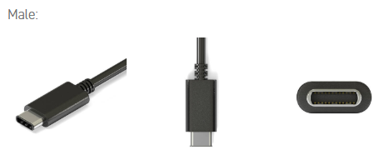
USB Type - C
USB Type-C connector is the newest USB connector on the market.
It has reversible/symmetrical design and can be plugged into any USB-C device using either end.
A USB-C cable is capable of carrying USB 3.1, USB 3.0, USB 2.0, and USB 1.1 signals.
Commonly paired with the USB-A, USB-B, USB Micro-B, and other USB connectors.
When connecting two USB 3.1 devices, support data transfer rates up to 10Gbps, enhanced power delivery of up to 20 volts, 5 amps, and 100 watts for power and charging
Built-in support for DisplayPort video and four channel audio (speaker and microphone).
Example: Latest mobiles, Mac Charger, Laptop Charger, etc.

Slide 11
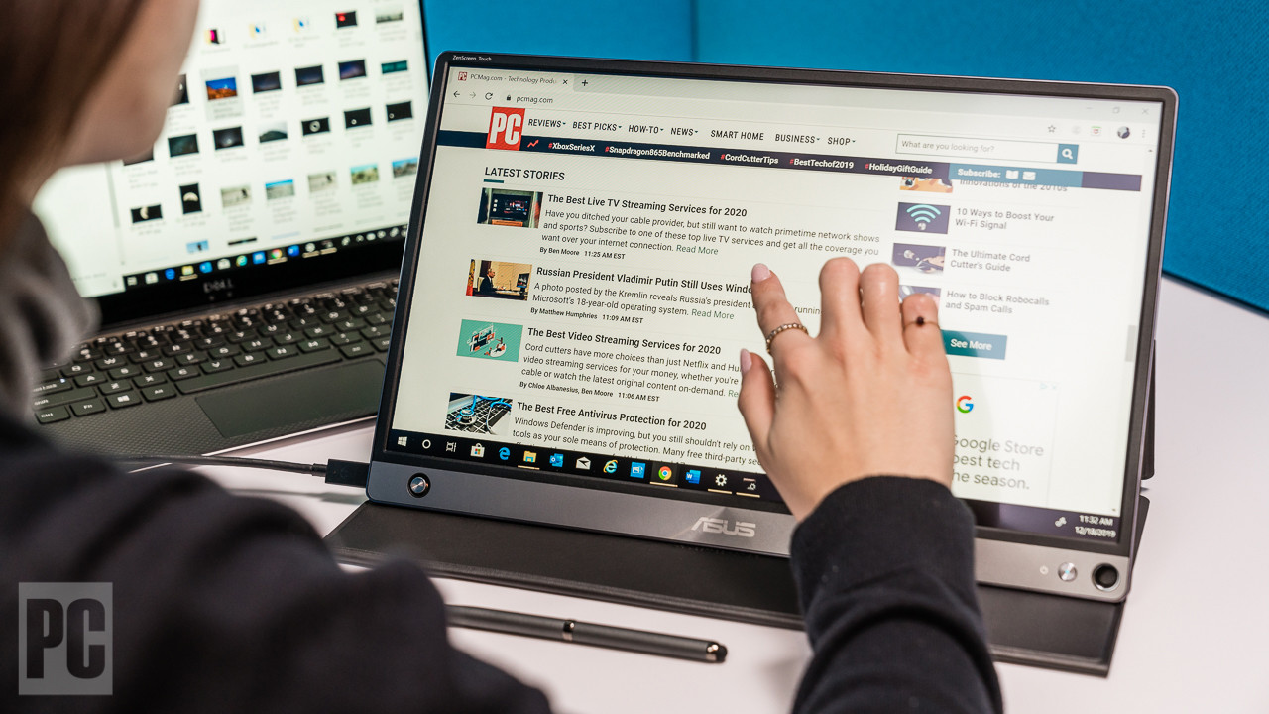
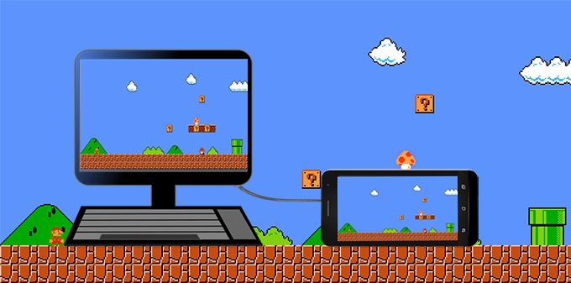
USB Type - C

Slide 12
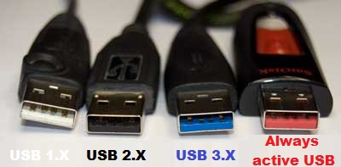
USB Ports

Slide 13
.
Thank You For Your Attention

